Slide 1
Security Scan Analysis Tool
Executive Summary
Service Line : System Compliance Services/SARM
Location : DC Hyderabad
9th July, 2014

Slide 2








One Purpose
Practices demonstrated in this story
Nine Practices
Three Values

Slide 3





Security Scan Analysis Tool
Protagonist
At the center of the action was…
Raviteja Poruri/Siddique - Architects
Mohmmad K Herehal - DOM
Pratibha Alamaraju - SDOM
Scene
Manual inspection is performed to verify security settings on every individual server to ensure all the settings are covered resulting in huge manual effort and due to human error, if any setting is missed, it will produce a risk of security breach which lead to penalties
Problem or opportunity
It is a tedious and difficult task for a SCS focal to go through each and every security setting provided in a technical specification spreadsheet and compare it with the Security Scan result which is obtained through TEM (Tivoli Endpoint Manager) tool. It takes huge time to complete verification for a single server and SCS team used to do it by sampling servers from each Platform/OS and compare them with the scan results. Human errors in verification is observed.
Action
SCS Hyderabad has come up with an idea of automating the Complete Analysis with less manual intervention to ensure 100% Security settings coverage and Compliance.
Solution
Earlier only two servers were checked randomly which was less than 2% of the total inventory, But now 100% check is possible using the Macro.
No more Audit findings over missing Security settings
Projects the compliance statistics for the management teams with respect to each platform.
Removal of manual monitoring, which is being carried out by SCS Team reducing tremendous amounts of Manual Analysis reducing strain to the Focal.
And this taught us – “When we have the solution , why live with a problem”

Slide 4
SCS - Security Scan Analysis Tool
What When Where Why
Why was this initiated
  ISeC Parameters / Settings were missing in the Security health check scan report covered by tool. (Audit findings in XcelEnergy, Hartford on missing settings)
Where this project is applicable
  Applicable on the accounts that are using IEM (IBM Endpoint Manager) Security Scan tool.
When will this be applicable
  Any Security Health Check (Official / Un-Official scans) to ensure all the ISeC settings are covered.
What does the project do
  Automate the Manual inspection required over checking for each setting on each server to ensure all the settings are being covered on all the servers. Also, additional feature to ensure all the servers been reported in the Security scan result.

Slide 5
SCS - Security Scan Analysis Tool
Pre Vs Post
PRE | POST
1. Sanity check - Two servers were randomly picked and monitored manually, the technical specifications were validated to understand and prepare Gap settings over the servers and were sent for Manual inspection to Platform support teams. | 1. Sanity Check - Full check is performed on complete inventory on all the settings and Macro will ensure to provide all the settings coverage for all the servers and prepare gap checklist accordingly.
2. Technical specifications mapping with Coverage metrics is performed manually to check what parameters are covered in respective fixlets in IEM. | 2. Technical specifications mapping with respect to coverage metrics is fully automated.
3. Validate the technical specifications manually with the tool and with the scan result to ensure proper configuration happened over the tool and tool is checking what is required over the server setting. | 3. Technical specification validation is automated. The configured parameters will be put up by the macro stating 'Desired Value' reducing any miss in wrong configuration.

Slide 6
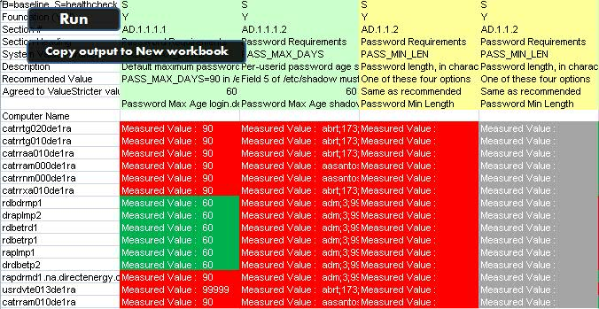
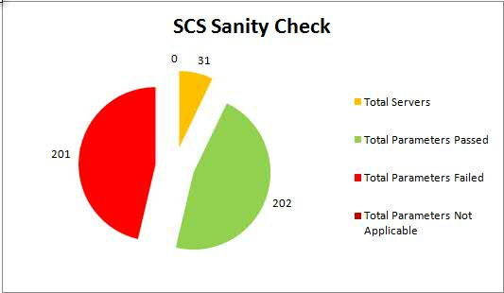
SCS - Security Scan Analysis Tool
Macro outcome projection

Slide 7
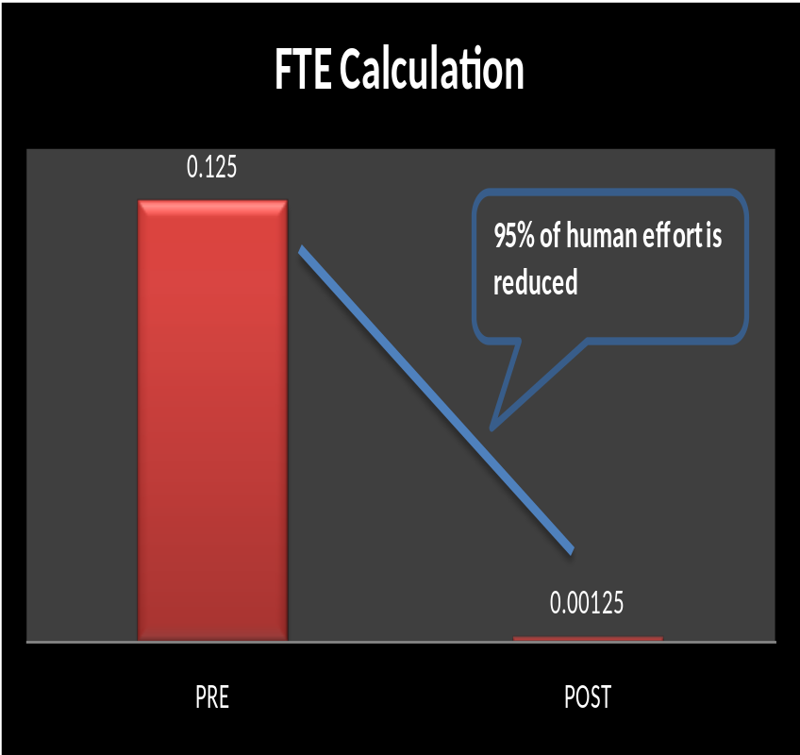
SCS - Security Scan Analysis Tool
FTE Calculation
LIST | PRE | POST
Time taken per setting in minutes | 1 | 0.01
Number of Settings per platform per week (On average) | 15 | 15
Number of servers per platform | 2 | 2
Number of platforms | 10 | 10
Time taken for 15 settings for 2 servers in Minutes | 30 | 0.3
Time taken for 15 settings for 2 servers for 10 platforms (In Minutes) | 300 | 3
Time taken for 15 settings for 2 servers for 10 platforms (In Hours) | 5 | 0.05
FTE Required to perform the above | 0.125 | 0.00125

Slide 8

Thank You!

